Slide 1
Data Structures and Algorithms Design
Febin.A.Vahab
2019-20

Slide 2
ONLINE SESSION 13 -PLAN
Sessions(#) | List of Topic Title | Text/Ref Book/external resource
13 | Quick Sort Algorithm. | T1: 5.2, 4.1, 4.3
Page <number>

Slide 3
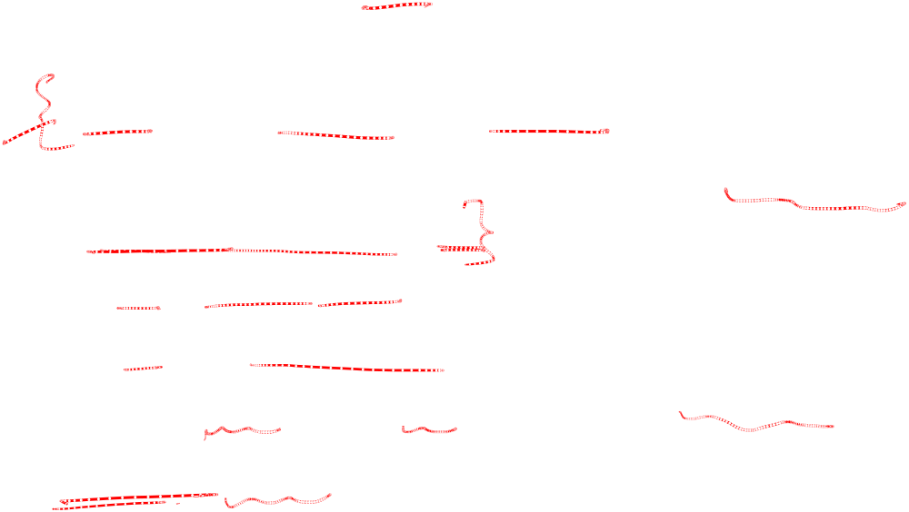
Quick-Sort
Quick-sort is a randomized sorting algorithm based on the divide-and-conquer paradigm:
  Divide: pick a random element x
  (called pivot) and partition S into
    L elements less than x
    E elements equal x
    G elements greater than x
  Recur: sort L and G
  Conquer: join L, E and G
x
x
L
G
E
x
Page <number>

Slide 4
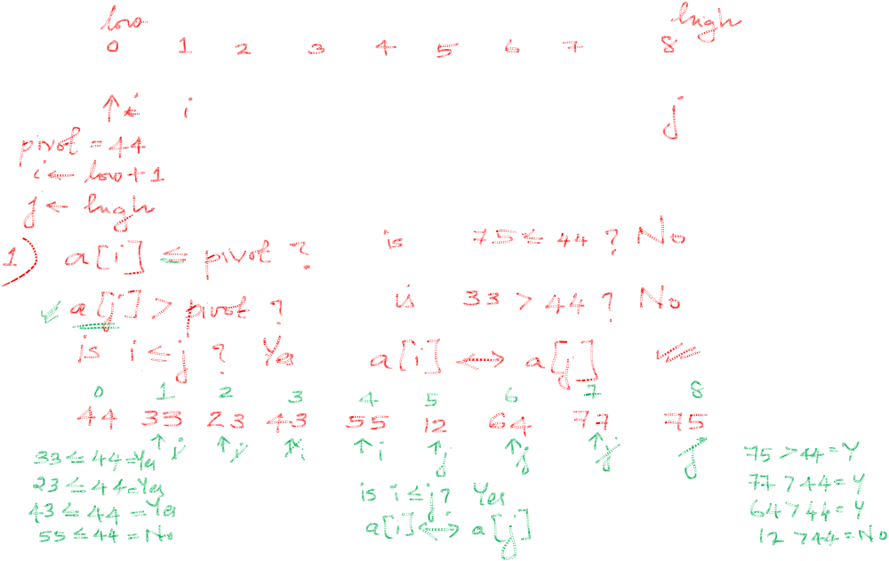
Quicksort
44 | 75 | 23 | 43 | 55 | 12 | 64 | 77 | 33
Page <number>

Slide 5
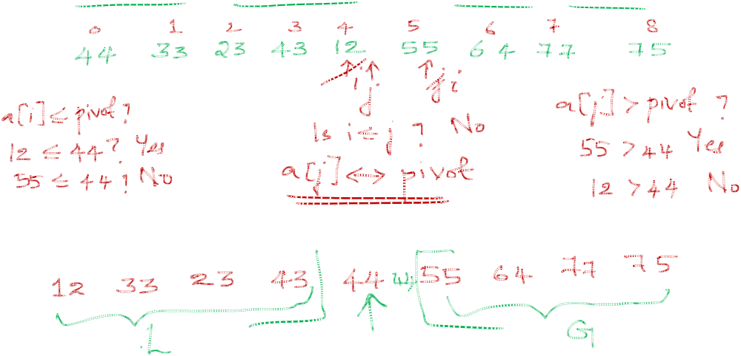
Quicksort
44 | 75 | 23 | 43 | 55 | 12 | 64 | 77 | 33
Page <number>

Slide 6
Quicksort
44 | 75 | 23 | 43 | 55 | 12 | 64 | 77 | 33
Page <number>

Slide 7
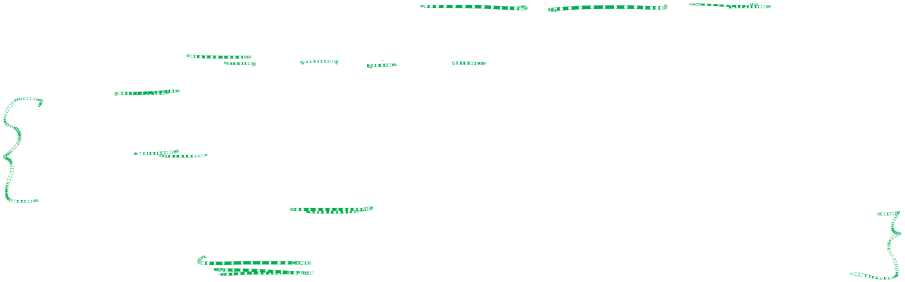
Partition
We partition an input sequence as follows:
  We remove, in turn, each element y from S and
  We insert y into L, E or G, depending on the result of the comparison with the pivot x
Each insertion and removal is at the beginning or at the end of a sequence, and hence takes O(1) time
Thus, the partition step of quick-sort takes O(n) time

Slide 8
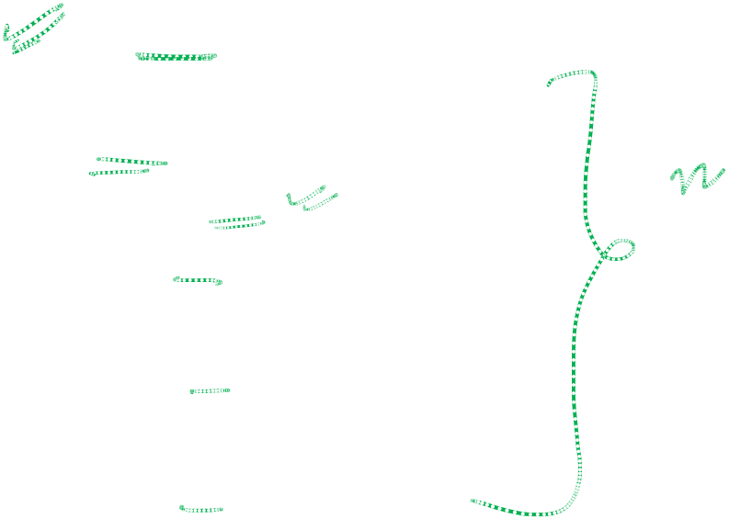
Partition
Algorithm partition(S, p)
Input sequence S, position p of pivot
Output subsequences L, E, G of the
elements of S less than, equal to,
or greater than the pivot, resp.
L, E, G ← empty sequences
  x ← S.remove(p)
  while ¬S.isEmpty()
  y ← S.remove(S.first())
  if y < x
  L.insertLast(y)
  else if y = x
  E.insertLast(y)
  else { y > x }
  G.insertLast(y)
  return L, E, G

Slide 9
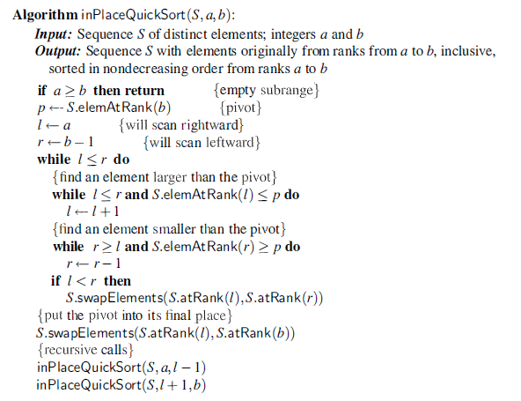
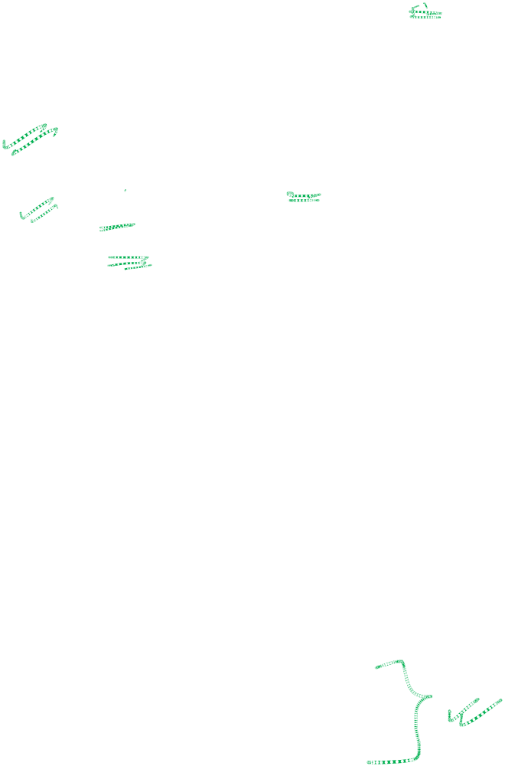
Quick-Sort

Slide 10
Quick-Sort Tree
An execution of quick-sort is depicted by a binary tree
  Each node represents a recursive call of quick-sort and stores
    Unsorted sequence before the execution and its pivot
    Sorted sequence at the end of the execution
  The root is the initial call
  The leaves are calls on subsequences of size 0 or 1
7 4 9 6 2 → 2 4 6 7 9
4 2 → 2 4
7 9 → 7 9
2 → 2
9 → 9

Slide 11
Execution Example
Pivot selection
7 2 9 4 3 7 6 1 → 1 2 3 4 6 7 8 9
7 2 9 4 → 2 4 7 9
3 8 6 1 → 1 3 8 6
2 → 2
9 4 → 4 9
3 → 3
8 → 8
9 → 9
4 → 4
Quick-Sort

Slide 12
Execution Example (cont.)
Partition, recursive call, pivot selection
7 2 9 4 3 7 6 1 → 1 2 3 4 6 7 8 9
2 4 3 1 → 2 4 7 9
3 8 6 1 → 1 3 8 6
2 → 2
9 4 → 4 9
3 → 3
8 → 8
9 → 9
4 → 4
Quick-Sort

Slide 13
Execution Example (cont.)
Partition, recursive call, base case
7 2 9 4 3 7 6 1 → → 1 2 3 4 6 7 8 9
2 4 3 1 →→ 2 4 7
3 8 6 1 → 1 3 8 6
1 → 1
9 4 → 4 9
3 → 3
8 → 8
9 → 9
4 → 4
Quick-Sort

Slide 14
Execution Example (cont.)
Recursive call, …, base case, join
7 2 9 4 3 7 6 1 → 1 2 3 4 6 7 8 9
2 4 3 1 → 1 2 3 4
3 8 6 1 → 1 3 8 6
1 → 1
4 3 → 3 4
3 → 3
8 → 8
9 → 9
4 → 4
Quick-Sort

Slide 15

Execution Example (cont.)
Recursive call, pivot selection
7 2 9 4 3 7 6 1 → 1 2 3 4 6 7 8 9
2 4 3 1 → 1 2 3 4
7 9 7 1 → 1 3 8 6
1 → 1
4 3 → 3 4
8 → 8
9 → 9
9 → 9
4 → 4
Quick-Sort

Slide 16
Execution Example (cont.)
Partition, …, recursive call, base case
7 2 9 4 3 7 6 1 → 1 2 3 4 6 7 8 9
2 4 3 1 → 1 2 3 4
7 9 7 1 → 1 3 8 6
1 → 1
4 3 → 3 4
8 → 8
9 → 9
9 → 9
4 → 4
Quick-Sort

Slide 17
Execution Example (cont.)
Join, join
7 2 9 4 3 7 6 1 → 1 2 3 4 6 7 7 9
2 4 3 1 → 1 2 3 4
7 9 7 → 17 7 9
1 → 1
4 3 → 3 4
8 → 8
9 → 9
9 → 9
4 → 4

Slide 18
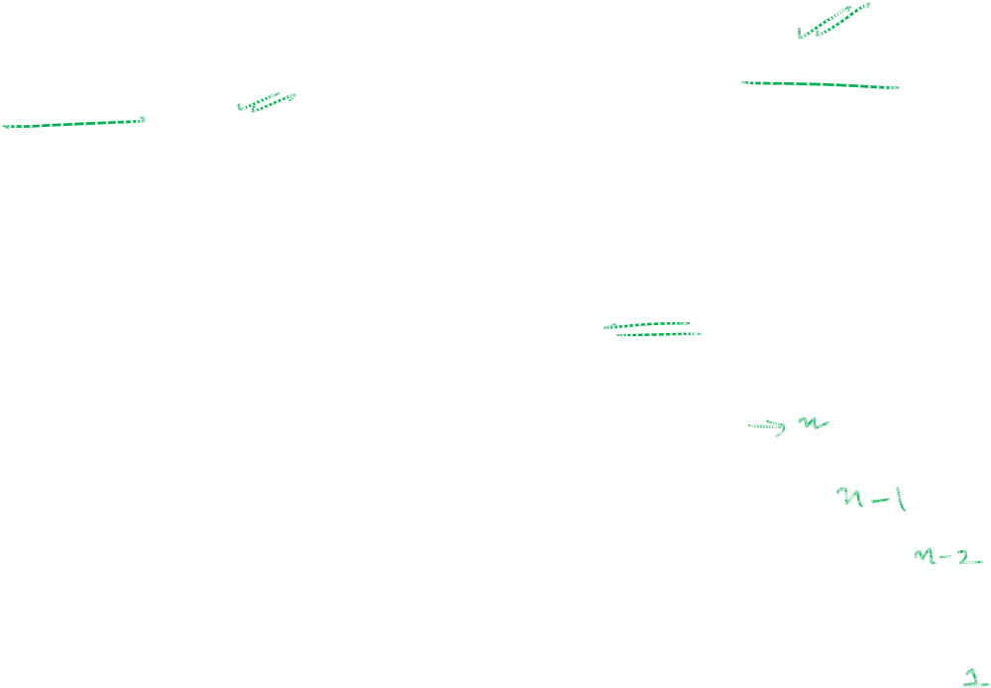
Worst-case Running Time
The worst case for quick-sort occurs when the pivot is the unique minimum or maximum element
One of L and G has size n − 1 and the other has size 0
The running time is proportional to the sum
n + (n − 1) + … + 2 + 1
Thus, the worst-case running time of quick-sort is O(n²)
depth | time
0 | n
1 | n − 1
… | …
n − 1 | 1
…

Slide 19
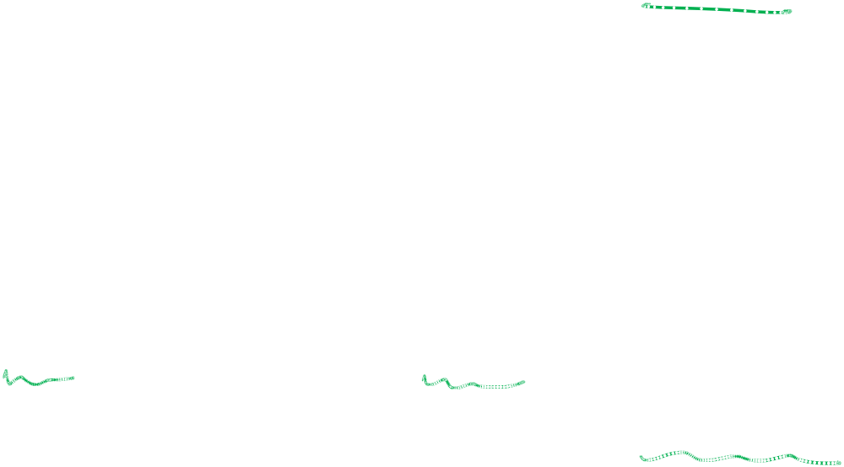
Best Case Analysis
Best case occurs when the partitions are as evenly balanced as possible
If the subarray has an odd number of elements and the pivot is right in the middle after partitioning, then each partition has (n-1)/2 elements.
If the subarray has an even number n of elements and one partition has n/2 and other having n/2-1.
In either of these cases, each partition has at most n/2 elements
Page <number>

Slide 20
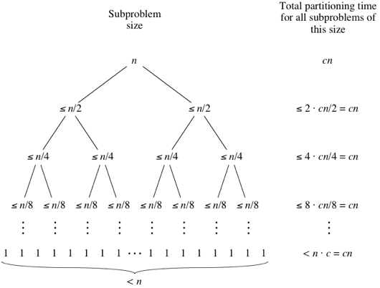
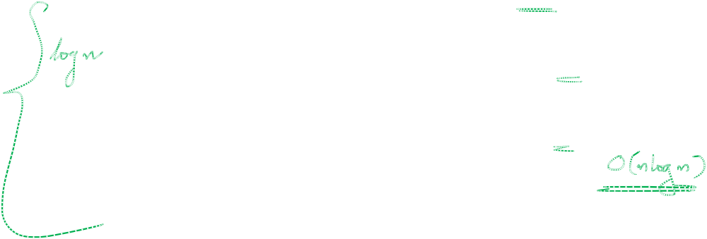
Best Case Analysis
Page <number>

Slide 21
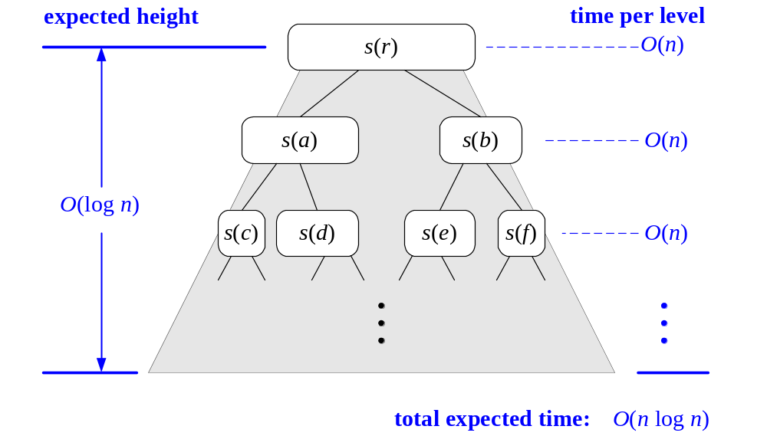
A visual time analysis of the quick-sort tree T

Slide 22
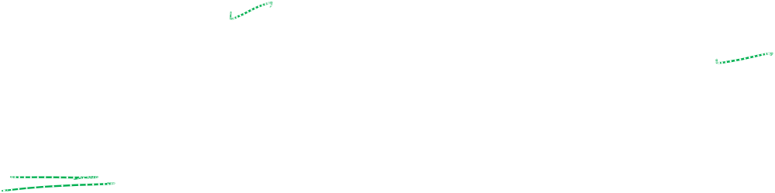
Best Case Running Time
The amount or work done at the nodes of the same depth is O(n)
The expected height of the quick-sort tree is O(log n)
Thus, the expected running time of quick-sort is O(n log n)

Slide 23
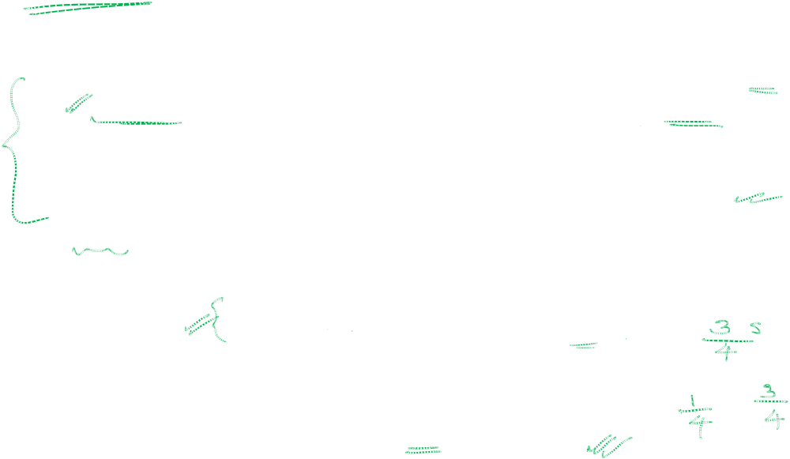
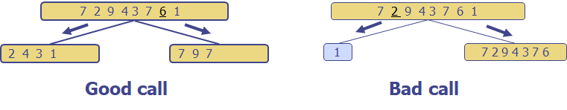
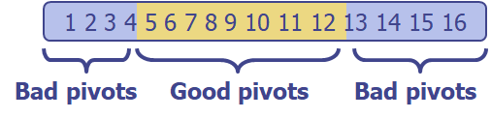
Expected Running Time
Consider a recursive call of quick-sort on a sequence of size s
  Good call: the sizes of L and G are each less than 3s/4
  Bad call: one of L and G has size greater than 3s/4
A call is good with probability 1/2
  1/2 of the possible pivots cause good calls:

Slide 24
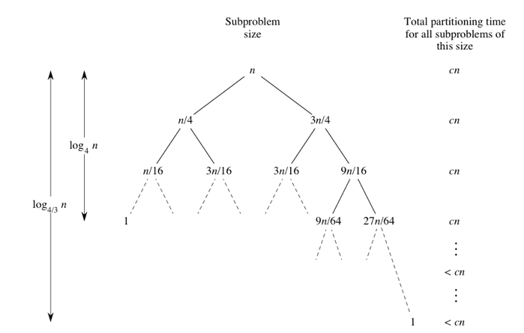
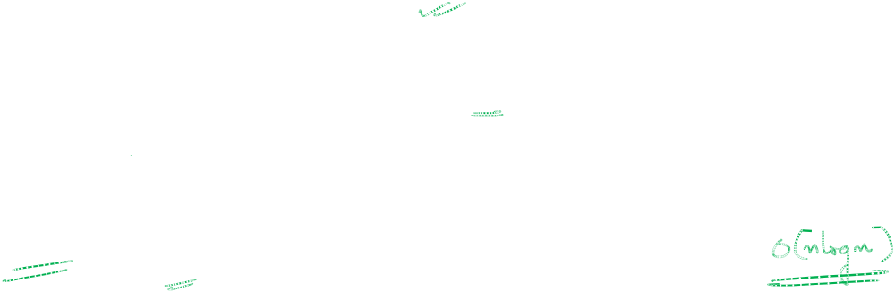
Expected Running Time
Page <number>

Slide 25
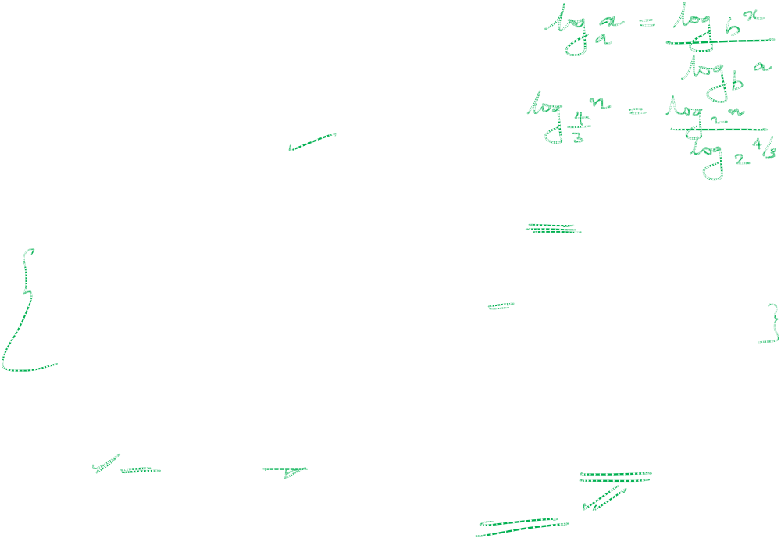
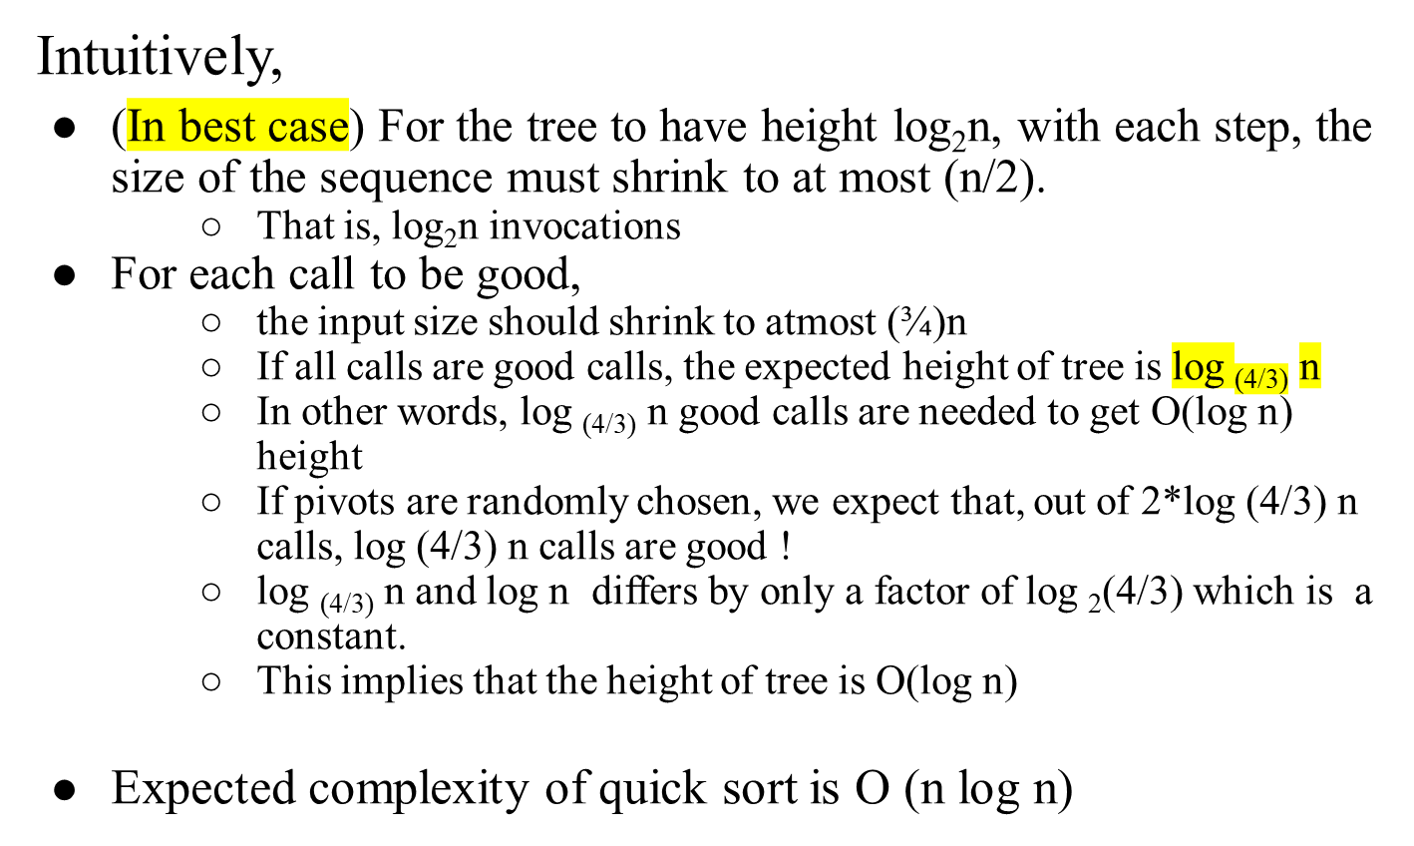
Expected Running Time

Slide 26
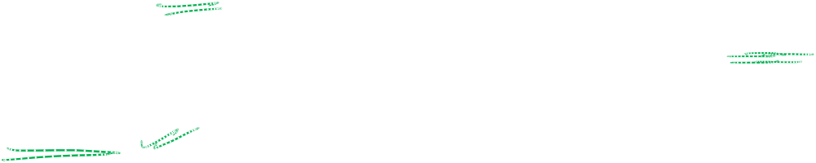
Expected Running Time
The amount or work done at the nodes of the same depth is O(n)
The expected height of the quick-sort tree is O(log n)
Thus, the expected running time of quick-sort is O(n log n)

Slide 27
In-Place Quick-Sort
A sorting algorithm is in-place if it uses only a constant amount of memory in addition to that needed for the objects being sorted themselves

Slide 28
In-Place Partitioning
Perform the partition using two indices to split S into L and E U G (a similar method can split E U G into E and G).
Repeat until j and k cross:
  Scan j to the right until finding an element > x.
  Scan k to the left until finding an element < x.
  Swap elements at indices j and k
j
k
3 2 5 1 0 7 3 5 9 2 7 9 8 9 7 6 9
(pivot = 6)
j
k
3 2 5 1 0 7 3 5 9 2 7 9 8 9 7 6 9

Slide 29
In-Place Quick-Sort
Quick-sort can be implemented to run in-place
In the partition step, we use replace operations to rearrange the elements of the input sequence such that
  the elements less than the pivot have rank less than h
  the elements equal to the pivot have rank between h and k
  the elements greater than the pivot have rank greater than k
The recursive calls consider
  elements with rank less than h
  elements with rank greater than k

Slide 30
In-Place Quick-Sort

Slide 31
In-Place Quick-Sort
85 | 24 | 63 | 45 | 17 | 31 | 96 | 50
l
r

Slide 32
In-Place Quick-Sort
85 | 24 | 63 | 45 | 17 | 31 | 96 | 50
l
r

Slide 33
In-Place Quick-Sort
Swap
85 | 24 | 63 | 45 | 17 | 31 | 96 | 50
l
r

Slide 34
In-Place Quick-Sort
31 | 24 | 63 | 45 | 17 | 85 | 96 | 50
l
r

Slide 35
In-Place Quick-Sort
Swap
31 | 24 | 63 | 45 | 17 | 85 | 96 | 50
l
r

Slide 36
In-Place Quick-Sort
31 | 24 | 17 | 45 | 63 | 85 | 96 | 50
l
r

Slide 37
In-Place Quick-Sort
31 | 24 | 17 | 45 | 63 | 85 | 96 | 50
r
l

Slide 38
In-Place Quick-Sort
Swap A[l] with pivot
31 | 24 | 17 | 45 | 63 | 85 | 96 | 50
r
l

Slide 39
In-Place Quick-Sort
31 | 24 | 17 | 45 | 50 | 85 | 96 | 63
r
l
Next Recursive Calls:
inPlaceQuickSort(A, a, l − 1)
inPlaceQuickSort(A, l + 1, b)

Slide 40
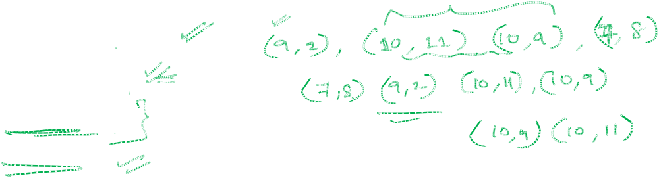
Quick-Sort Properties
Not Adaptive
Not Stable
Not online
In Place
Page <number>

Slide 41
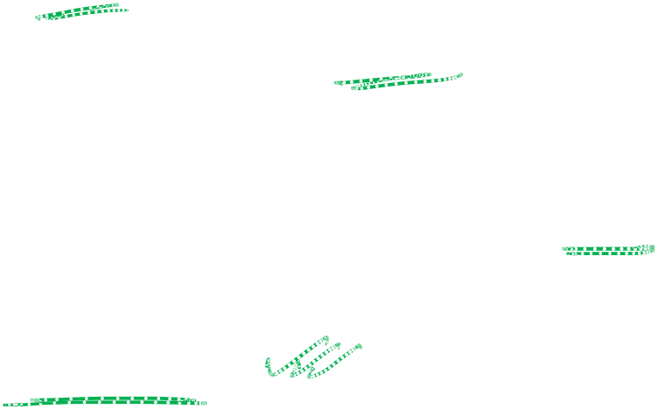
QuickSort
Advantages of Quicksort
Its average-case time complexity to sort an array of n elements is O(nlogn).
It requires no additional memory.
Disadvantages of Quicksort
Its worst-case running time, O(n²) to sort an array of n elements, happens when pivot is an extreme
It is not stable.
Page <number>

Slide 42
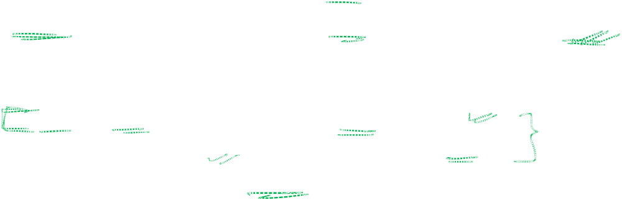
QuickSort and MergeSort
In most practical situations, quicksort is the method of choice.
If stability is important and space is available, merge sort might be best.
The primary practical implications of these choices are to trade
  speed and memory usage (for primitive types) Quicksort for
  stability and guaranteed performance (for reference types).-Mergesort
Merge Sort: used in database scenarios, because stable and external (results don’t all fit in memory).
Page <number>

Slide 43
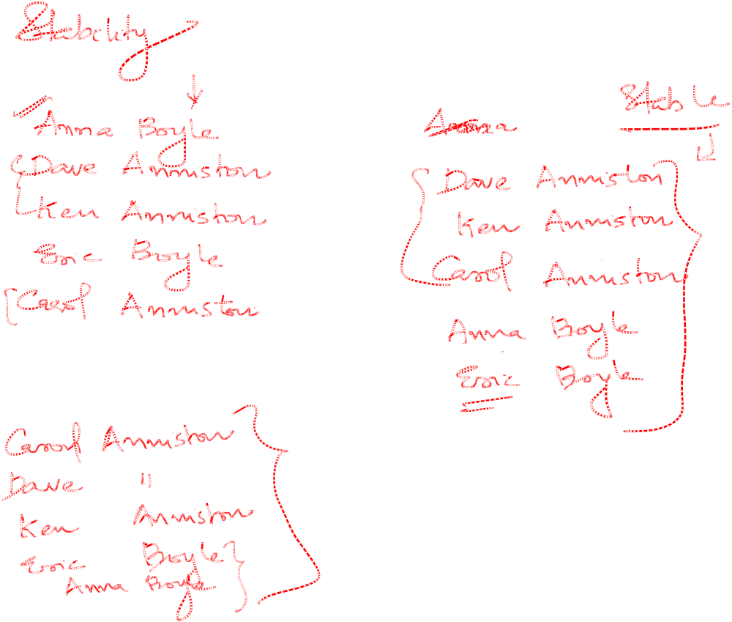
Page <number>

Slide 44
THANK YOU!

